Slide 1
Quiz 3.1-3.4 HW 3.6 & 3.7
Answers to the difficult/tricky ones

Slide 2
Quiz #5, 6

Slide 3
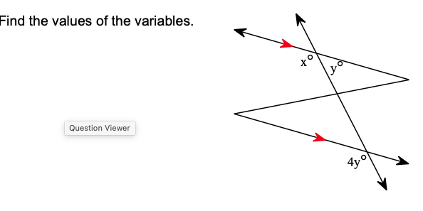
Quiz # 16

Slide 4
3.6 #15

Slide 5
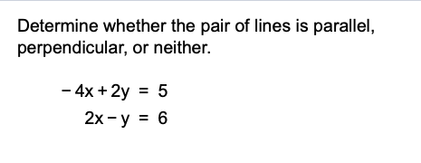
3.6 #16

Slide 6
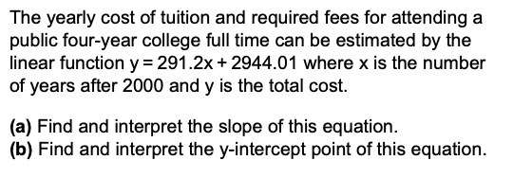
3.6 # 19

Slide 7
3.6 #20

Slide 8
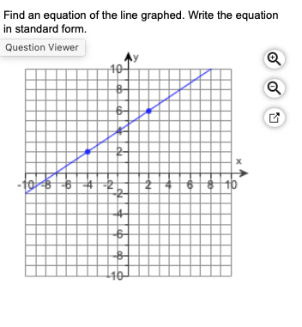
3.7 #9

Slide 9
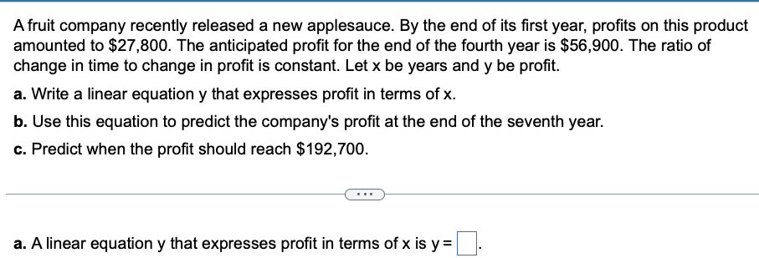
3.7 #17
Let's use your SLOPE program and some Graphing /Table features of your TI-84

Slide 10
3.7 #20

